Slide 1

ECE 2001 Basic Circuit Theory
Lecture 2
Circuit Analysis Techniques

Slide 2
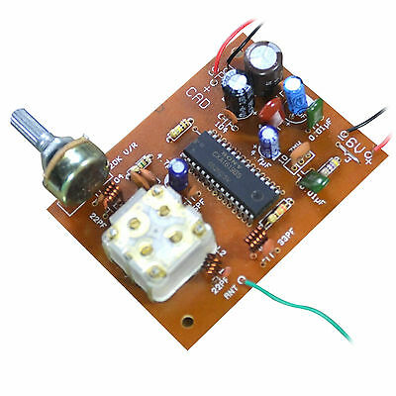
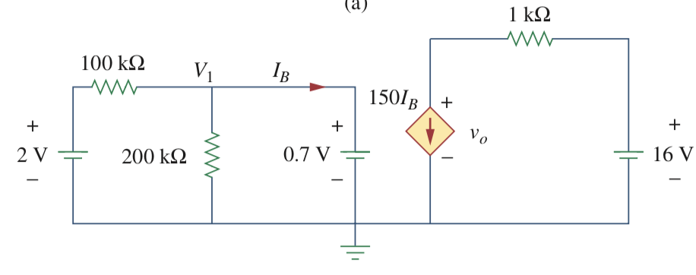
An understanding of the operation and analysis of electronics is essential to an electrical engineer.
This lecture focuses on analyzing voltages and currents in a circuit.
This will be an application of KCL, KVL, and Ohm’s law.
It is also required to solve linear equations.
Notes:
Example: applying basic laws (KCL, KVL, Ohm’s law) to directly solve a circuit

Slide 3
Outline
Nodal analysis
  circuits w/o a voltage source
  circuits w/ a voltage source (supernode trick)
Mesh analysis
  Circuits w/o a current source
  Circuits w/ a current source (supermesh trick)
Nodal analysis versus Mesh analysis
Notes:
Nodal analysis applies to any circuit; while mesh only to planar circuits. Computational circuit analysis using PSpice (Personal Simulation Program with Integrated Circuit Emphasis) also requires this fundamentals. See also the user forum: www.pspice.com

Slide 4
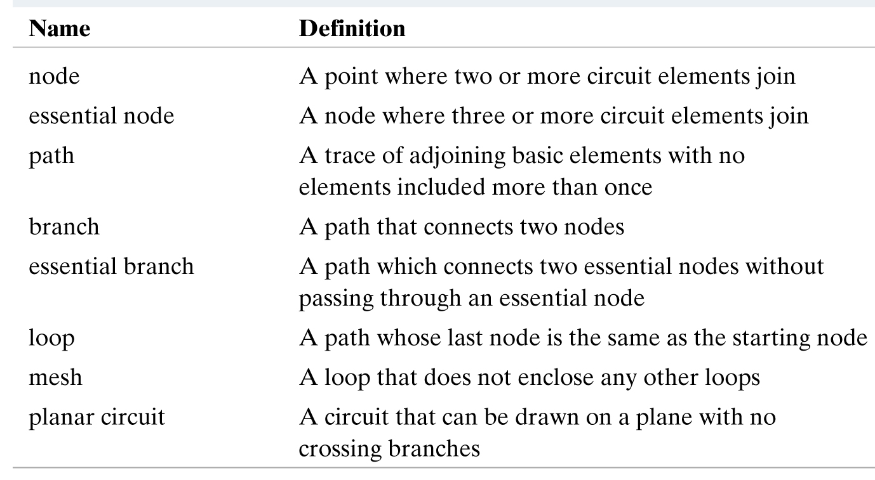
Terminology

Slide 5
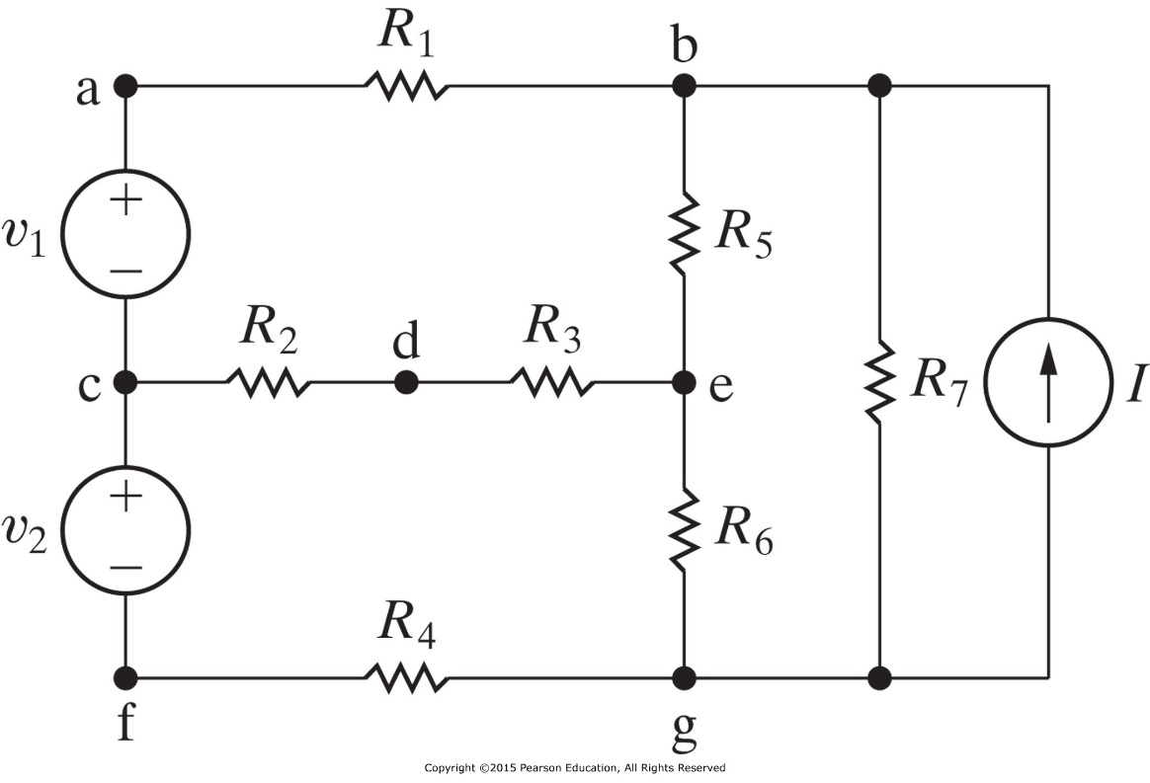
Terminology Example
The nodes are a, b, c, d, e, f, and g. n=7.
Nodes b, c, e, and g are essential. n_{e}=4.
The branches are v₁, v₂, R₁, R₂, R₃, R₄, R₅, R₆, R₇, and I. b=10.
The essential branches are v₁ - R₁, R₂ - R₃, v₂ - R₄, R₅, R₆, R₇, and I. b_{e}=7.
The meshes are v₁ - R₁ - R₅ - R₃ - R₂, v₂ - R₂ - R₃ - R₆ - R₄, R₅ - R₇ - R₆, and R₇ - I. l=4.
R₁ - R₅ - R₆ is a path, but it is not a loop, nor an essential branch.
v₁ - R₁ - R₅ - R₆ - R₄ - v₂ is a loop but not a mesh. I - R₅ - R₆ is also a loop but not a mesh.
Remark: Alternatively, we may consider I - R₅ - R₆ a mesh and R₅ - R₇ - R₆ not a mesh.
Why is that so?
Notes:
Number of meshes: b-(n-1)=b_e-(n_e-1). The number of unknown is b_e (implying the number of independent equations is b_e); the number of independent KCL equations is n_e-1; the number of independent KVL equations is b_e-(n_e-1).

Slide 6
Why study systematic methods for “not-so-simple” resistive circuits?
So far, we have analyzed relatively simple resistive circuits.
But as the circuits become more structurally complicated and involve more elements, applying the basic laws directly becomes cumbersome.
Two techniques will be introduced here:
  Nodal analysis (node-voltage method), which is based on Kirchhoff current law (KCL).
  Mesh analysis (mesh-current method), which is based on Kirchhoff voltage law (KVL).
Nodal analysis applies to any circuit; while mesh only to planar circuits.
These techniques give two systematic methods of describing the circuits with the minimum number of simultaneous equations.

Slide 7
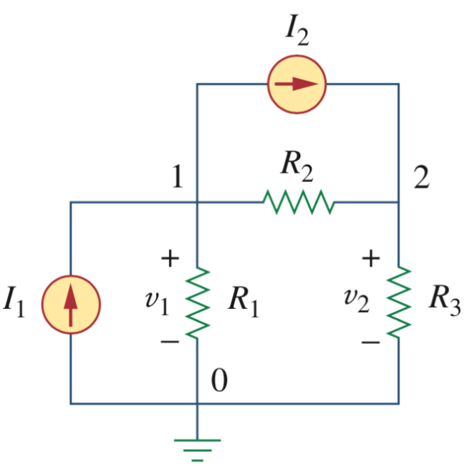
Nodal analysis in a nutshell: A simple problem
Focus on voltage variables
Currents are expressed in terms of voltages (using Ohm’s law)
Use KCL at each node to form equations
Problem: Find the voltages and currents in the circuit

Slide 8
Nodal Analysis – 3 Basic Steps
Assign voltage variables to each node
Form equations: apply KCL at each node (with Ohm’s law)
Solve the resulting equations

Slide 9
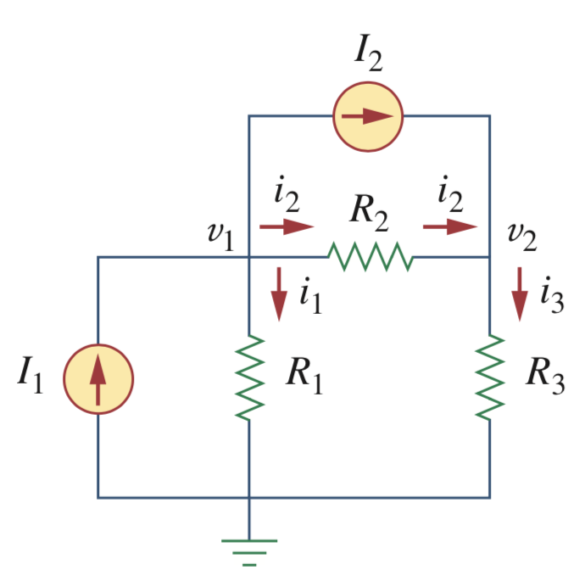
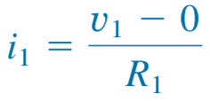
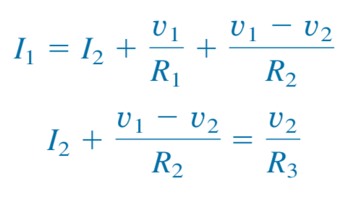
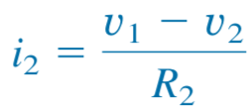
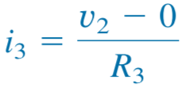
Nodal Analysis – 3 Basic Steps
Assign voltage variables to each node
Form equations: apply KCL at each node (with Ohm’s law)
Solve the resulting equations
Ohm’s law:
KCL:
(KCL at node 1)
(KCL at node 2)
Question: do we need to apply KCL at node 0?

Slide 10
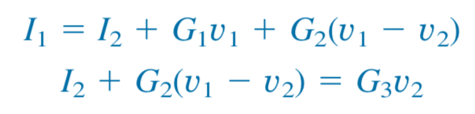
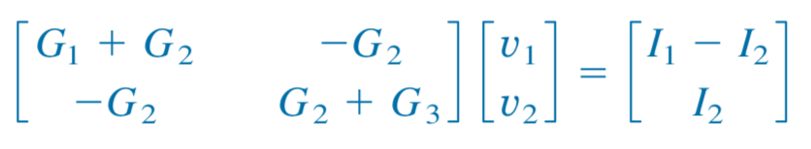
Nodal Analysis – 3 Basic Steps
Assign voltage variables to each node
Form equations: apply KCL at each node (with Ohm’s law)
Solve the resulting equations
If we express resistance as conductance, e.g., G1=1/R1,
we can write the equations in matrix form as
(This can be solved using techniques in linear algebra)

Slide 11
Discussion on Step 1: node selection
Issue 1: Where to set the reference node?
Issue 2: Which nodes to pick for analysis? Do we pick nodes a, c, d, f?

Slide 12

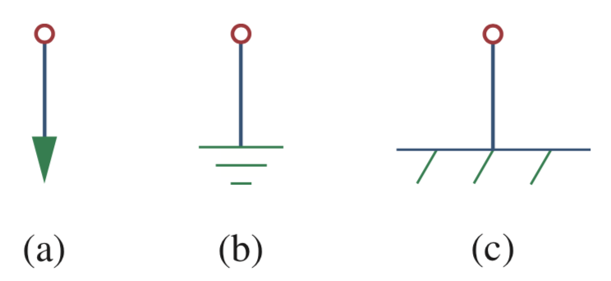
Discussion on Step 1: node selection
Issue 1: Where to set the reference node?
Issue 2: Which nodes to pick for analysis? Do we pick nodes a, c, d, f?
Reference node selection:
Select a node that can ease your computation
Common symbols for indicating a reference node, (a) common ground, (b) ground, (c) chassis ground.
Notes:
Common ground and Ground both can be used to represent the real ground. (b) is more commonly used.

Slide 13
Discussion on Step 1: node selection
Issue 1: Where to set the reference node?
Issue 2: Which nodes to pick for analysis? Do we pick nodes a, c, d, f?
Rule: We only need to select essential nodes!
Essential node: a point where three or more circuit elements join
Here, nodes b, c, e, and g are essential.
Q: How many variables?
Q: How many independent equations?

Slide 14
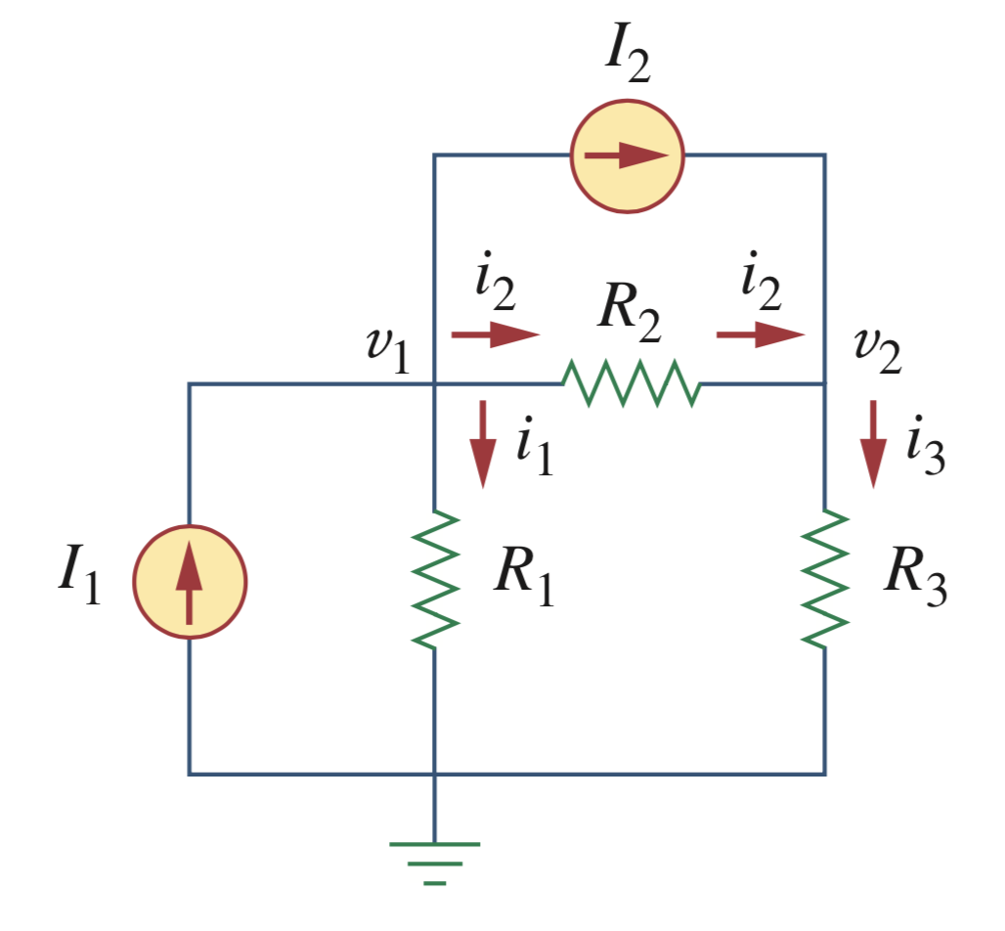
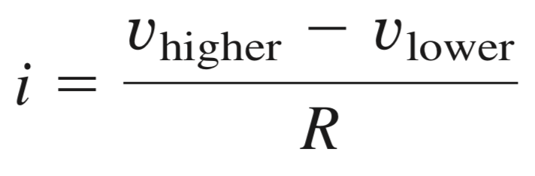
Discussion on Step 2: Using KCL and Ohm’s law to form equations
Define the direction of the current at each branch
Be careful about the sign
Start of the arrow
End of the arrow
(Ohm’s law)
Notes:
This is actually a restatement of Ohm’s law: when current flows through a resistor, voltage drops.

Slide 15
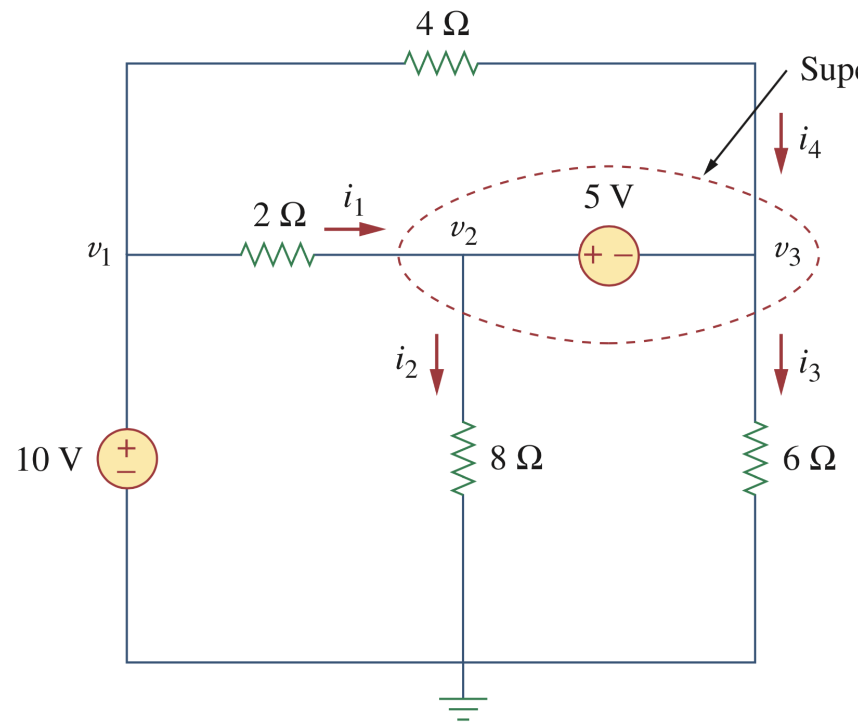
Discussion on Step 2: What if there is a voltage source?
What is the problem with a voltage source?
  Ans: Cannot use Ohm’s law to determine the
  current (required by KCL)
Solutions
  Direct method: (i) form an equation using the voltage difference, and/or (ii) analyze a relevant and possibly inessential node
  (Usually, an additional variable needed)
  Supernode method: form a supernode and apply KCL on the supernode; then apply KVL
  (When you don’t want to introduce a new variable)

Slide 16
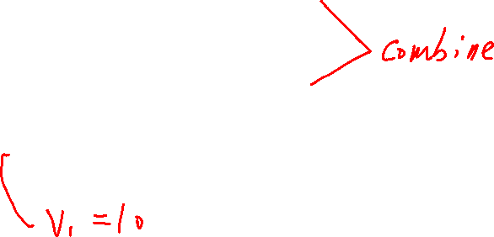
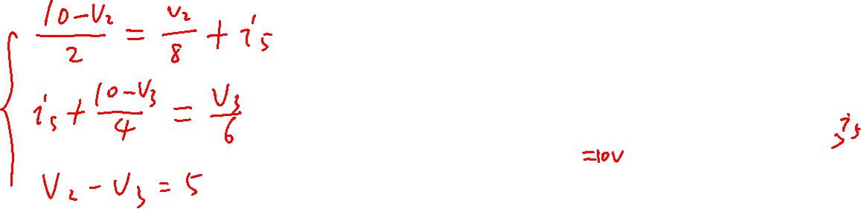
Direct method: (i) form an equation using the voltage difference

Slide 17
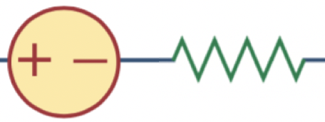
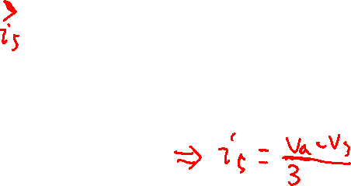
Supplementary on the direct method: analyze a relevant and possibly inessential node
Although node a is inessential (a node that connects only two circuit elements), adding node a to the nodal analysis helps:
One more variable v_{a},
One more equation:
v₂ – v_{a} = 5
5 V
3 Ω
a

Slide 18
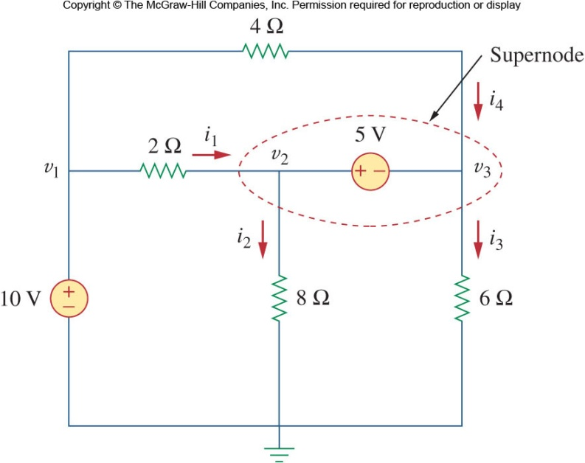
More details on the supernode trick
Depending on what nodes the source is connected to, the approach varies.
Between the reference node and a non-reference mode:
  Set the voltage at the non-reference node to the voltage of the source
  In the example circuit :
Between two non-reference nodes
  The two nodes form a supernode.
  A supernode is formed by enclosing a (dependent or independent) voltage source connected between two non-reference nodes and any elements connected in parallel with it.

Slide 19
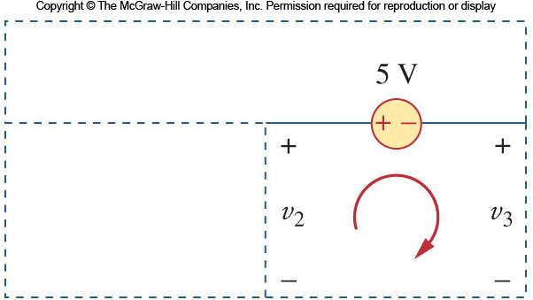
More details on the supernode trick
In order to apply KVL to the supernode in the example, the circuit is redrawn as shown.
Going around this loop in the clockwise direction gives:
Why Supernode?
  Nodal analysis requires applying KCL
  The current through the voltage source cannot be known in advance (Ohm’s law does not apply)
  By lumping the nodes together, the current balance can still be described
Note the following properties of a supernode:
  The voltage source inside the supernode provides a constraint equation needed to solve for the node voltages
  A supernode has no voltage of its own
  A supernode requires the application of both KCL and KVL

Slide 20

More details on the supernode trick
In the example circuit node 2 and 3 form a supernode
From Ohm’s Law:
Apply KCL at supernode:
Or this can be expressed as:

Slide 21

More details on the direct method
Define branch currents
Apply KCL to nodes v₂ and v₃
Apply KCL to node v_{1 ,}
Apply Ohm’s law to the branches
Constraints:
Thus arriving at the same 3 equations as before.
i₅
i₆

Slide 22
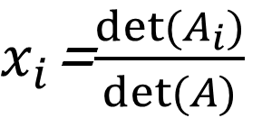

* Discussion on Step 3: How to solve the equations in a more general way? – Cramer’s rule
In linear algebra,
where A is a matrix, b and x is a vector.
If A has non-zero determinant, then the theorem states that in this case the system has a unique solution, whose individual values for the unknowns are given by:
where A_{i} is the matrix formed by replacing the i^{th} column of A by the column vector b.
$$Ax=b$$
$x_{i}$=$\frac{det⁡(A_{i})}{det⁡(A)}$

Slide 23
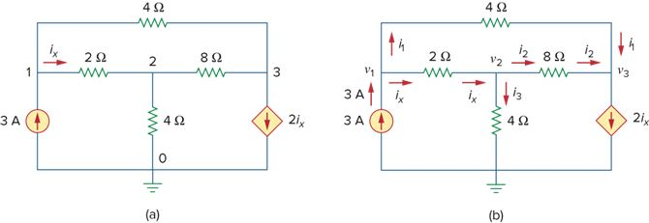
Example 1
Determine the nodal voltages
How many essential nodes?
Taking node 0 as the reference node, 3 unknown nodal voltages remain. There are also 4 unknown branch currents. Use Ohm’s law equations to replace the currents in the form of three nodal voltages, resulting in 3 equations.
Indicate unknowns

Slide 24
Example 1
Unit of current in A and voltage in V.
At node 1:
At node 2:
At node 3:

Slide 25
Example 1
Three equations with three unknowns v’s to solve:
Applying Cramer’s rule:
Similarly,

Slide 26
Nodal analysis – with voltage source
When a voltage source is the only element between two essential nodes, the node-voltage method can be simplified.
In general, when you use the node-voltage method to solve circuits that have voltage sources connected directly between essential nodes, the number of unknown node voltages is reduced.
The reason is that, whenever a voltage source connects two essential nodes, it constrains the difference between the node voltages at these nodes to equal the voltage of the source.

Slide 27
Summary of Nodal Analysis
The aim is to find the nodal voltages relative to that of a reference.
Given a circuit with n nodes, without voltage sources, the nodal analysis is accomplished via three steps:
  Select a convenient node as the reference node. Assign voltages v₁,v₂,…v_{n} to the remaining n-1 nodes.
  Apply KCL to each of the n-1 non-reference nodes.
  Use Ohm’s law to express the branch currents in terms of node voltages.
  Solve the resulting n-1 simultaneous equations to obtain the unknown node voltages.
For the case of with voltage sources, a supernode method with KVL may be used (or via the direct method).

Slide 28
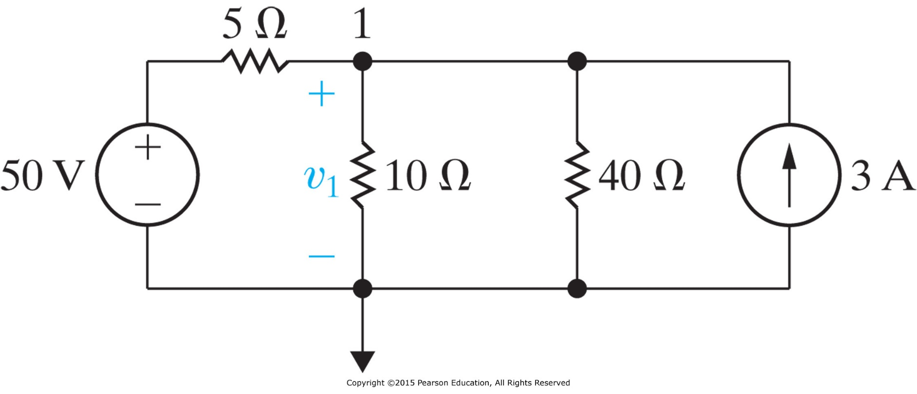
Practice
(a) Use Nodal analysis to find the branch current through three resistors.
(b) Find the power associated with each source, and state whether the source is delivering or absorbing power.

Slide 29
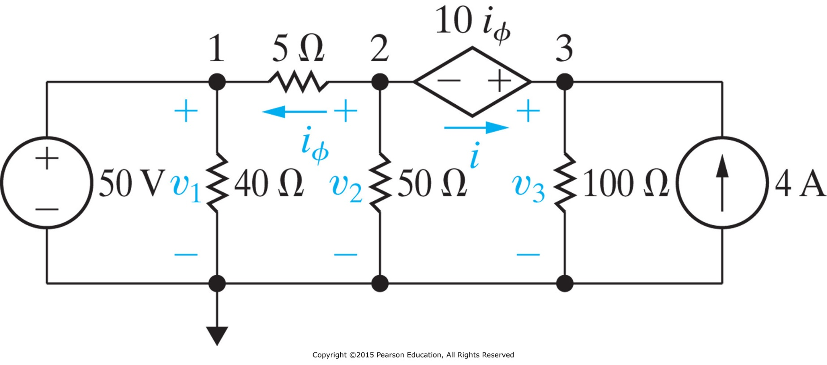
Practice
We can combine node 2 and 3 to form a Supernode
Apply KCL on the closed
boundary

Slide 30
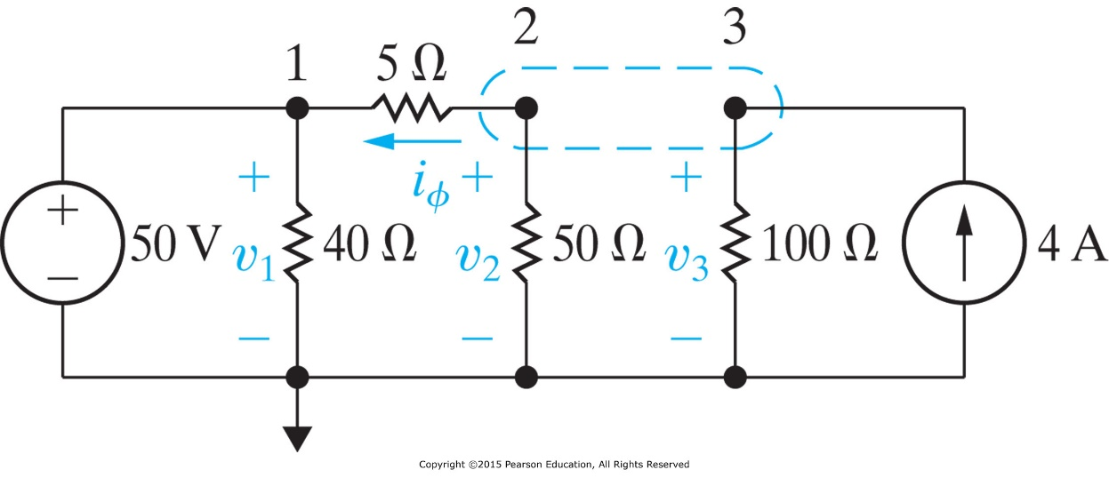
Practice
n_{e}=4 essential nodes.
n_{e}-1=3 nodal voltages v₁, v₂, and v₃ as variables.
Voltage of node 1 is fixed.
Nodes 2 and 3 make up a supernode.
Variables: v₂ and v₃
Apply KCL to the supernode,
Constraints:

Slide 31
Outline
Nodal analysis
  circuits w/o a voltage source
  circuits w/ a voltage source (supernode trick)
Mesh analysis
  Circuits w/o a current source
  Circuits w/ a current source (supermesh trick)
Nodal analysis versus Mesh analysis
Notes:
Nodal analysis applies to any circuit; while mesh only to planar circuits. Computational circuit analysis using PSpice (Personal Simulation Program with Integrated Circuit Emphasis) will also be introduced here. See also the user forum: www.pspice.com

Slide 32
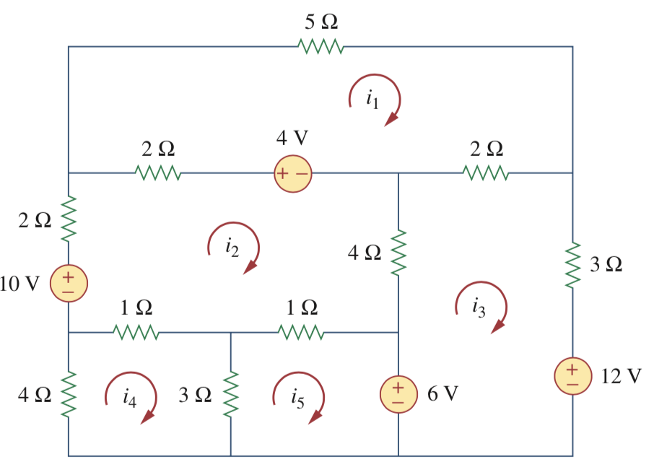
What is a mesh?
A mesh is a loop that does not contain any other loop within it, where a loop is a closed path with no node passed more than once
This is a mesh and the current i₁ is called mesh-current
This is NOT a mesh

Slide 33
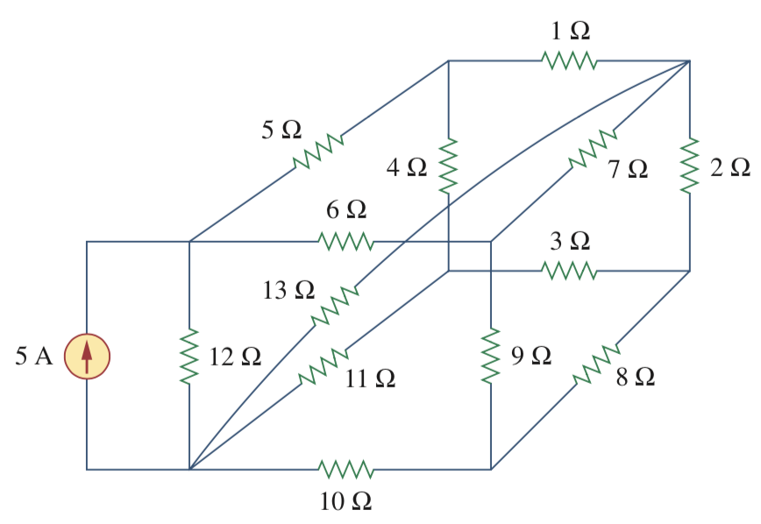
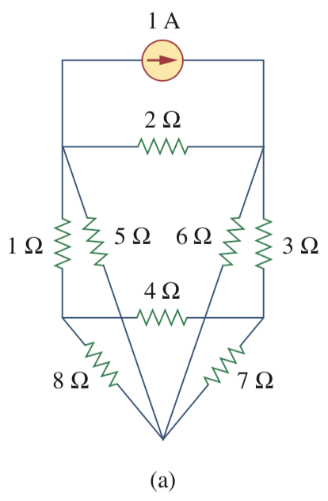
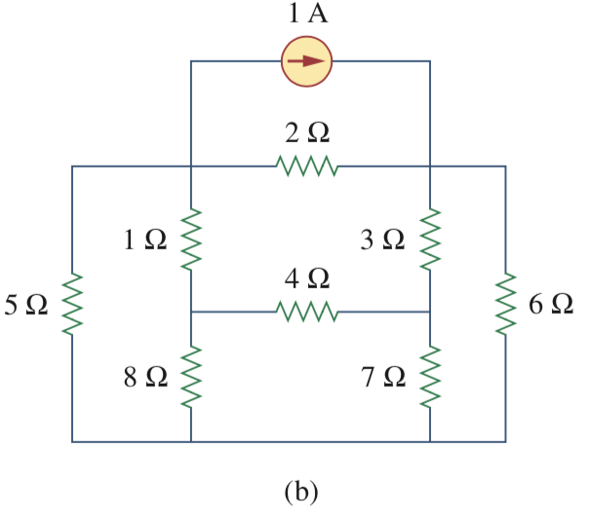
Mesh analysis only applies to planar circuits
A planar circuit is one that can be drawn in a plane with no branches crossing one another; otherwise it is nonplanar.
Example of a nonplanar circuit
The branch with the 13Ω resistor prevents the circuit from being drawn without crossing branches. Question: what if the diagonal 13 W resistor is removed?
Circuit (a) is a planar circuit because it can be equivalently drawn as (b), which has no cross branches

Slide 34
Mesh analysis in a nutshell
Focus on current variables
Voltages are expressed using currents (Ohm’s law)
Use KVL for each mesh to form equations

Slide 35
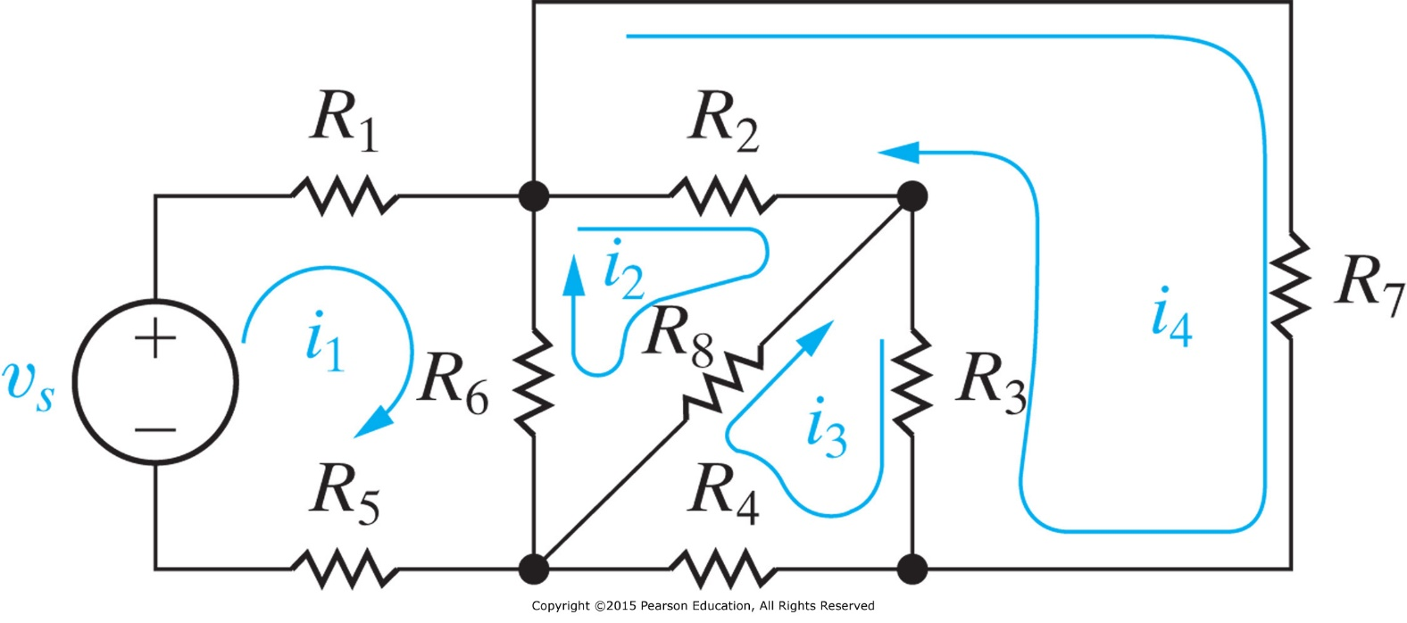
Basic Steps for Mesh Analysis
Assign mesh currents to each mesh
Apply KVL along each mesh loop
Solve the resulting equations

Slide 36
Mesh currents are NOT branch currents
A mesh current is the current that exists only in the perimeter of a mesh; it may pass through many different branches.
Not always equal to a branch current.
May not be measurable, e.g. i₂ (all elements in that mesh are shared)
Note: Mesh current is just a virtual component. For example, the actual current I₂ that flows in R₂ equals to i₂ - i₄
I₂
Caution: KVL computes the actual voltage, which is computed using the actual current over the Ohm’s law.

Slide 37
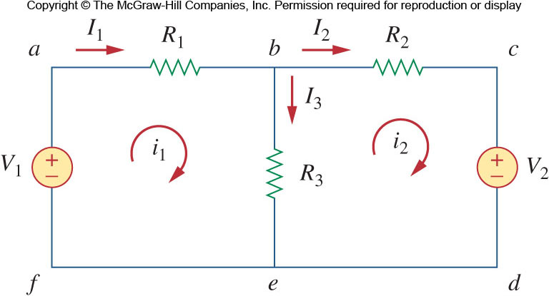
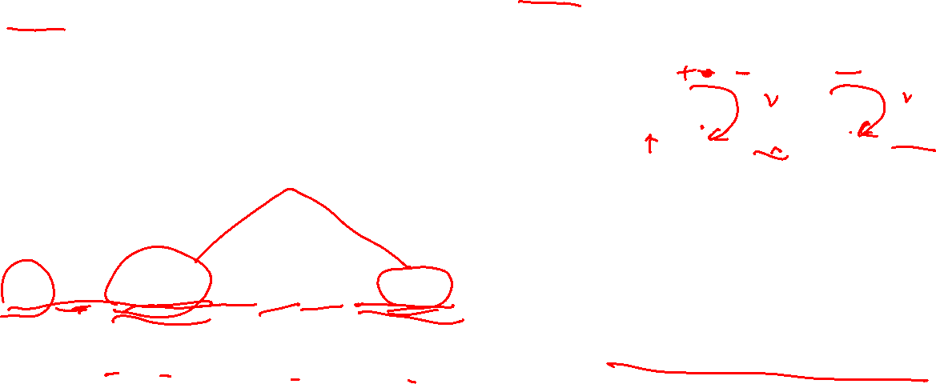
Mesh Analysis Example
Consider only essential nodes and branches, n_{e}=2, b_{e}=3, l=b_{e}-(n_{e}-1)=2.
The above circuit has two loops that are meshes (abefa and bcdeb).
The outer loop (abcdefa) is a loop, but not a mesh.
First, mesh currents i₁ and i₂ are assigned to the two meshes.
Applying KVL to the meshes:
Notes:
Note: the outer loop is considered as a mesh from the mappable point of view.

Slide 38
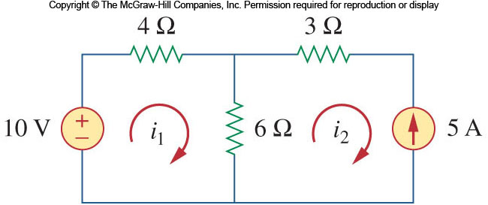

Mesh Analysis with Current Sources: Direct method and supermesh method
Same as the voltage source in Nodal Analysis, the presence of a current source makes the mesh analysis simpler in that it reduces the number of equations.
If the current source is located on only one mesh, the current for that mesh is defined by the source.
For example:
Here, the current i₂ is equal to -5A

Slide 39
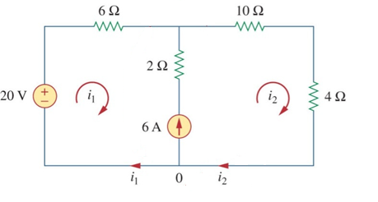
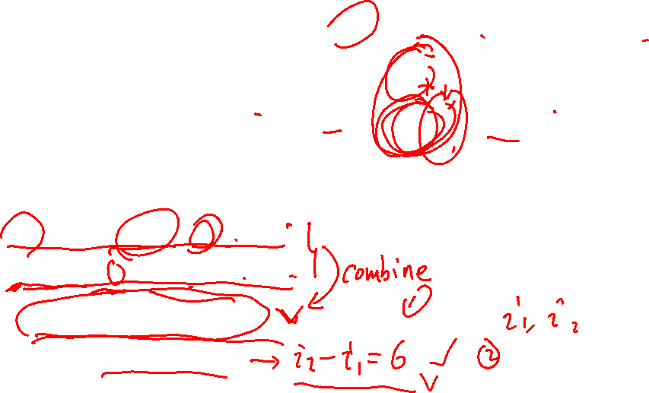
Direct method
Same circuit as before.
Let the voltage on the 6 A current source be v
Apply KVL to meshes 1 and 2: note the sign of the common elements
Eliminating v:
Apply KCL to ground node:
Same two equations as using the supermesh case.
+
v
_

Slide 40
Supermesh method (when I don’t want to introduce an additional variable)
Similar to the case of nodal analysis where a voltage source shared two non-reference nodes, current sources (dependent or independent) that are shared by more than one mesh need special treatment.
The voltage across a current source cannot be known in advance.
The two meshes must be joined together, resulting in a supermesh.
The supermesh is constructed by merging the two meshes and excluding the shared source and any elements in series with it.
A supermesh is required because mesh analysis uses KVL.
Intersecting supermeshes in a circuit must be combined to form a larger supermesh.

Slide 41
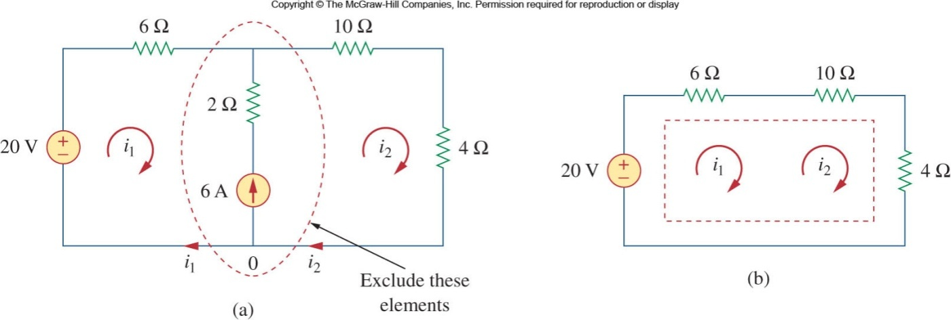
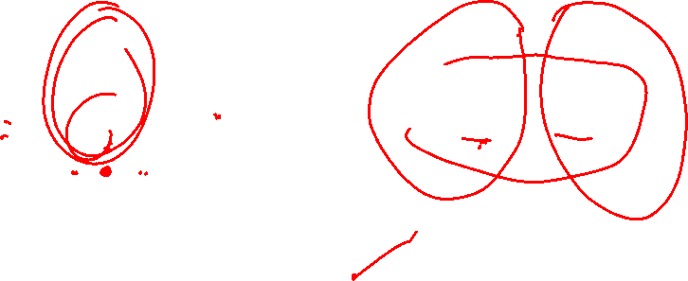
Supermesh method with an example: Apply KVL over a supermesh loop
In this example, a 6A current course is shared between mesh 1 and 2.
The supermesh is formed by merging the two meshes.
The current source and the 2Ω resistor in series with it are also removed.

Slide 42
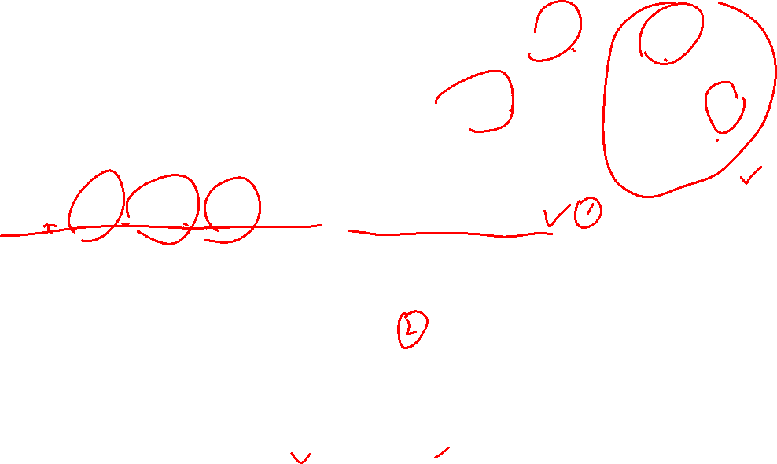
Supermesh Example
Apply KVL to the supermesh
We next apply KCL to the node in the branch where the two meshes intersect.
Solving these two equations we get:
Note that the supermesh required using both KVL and KCL

Slide 43
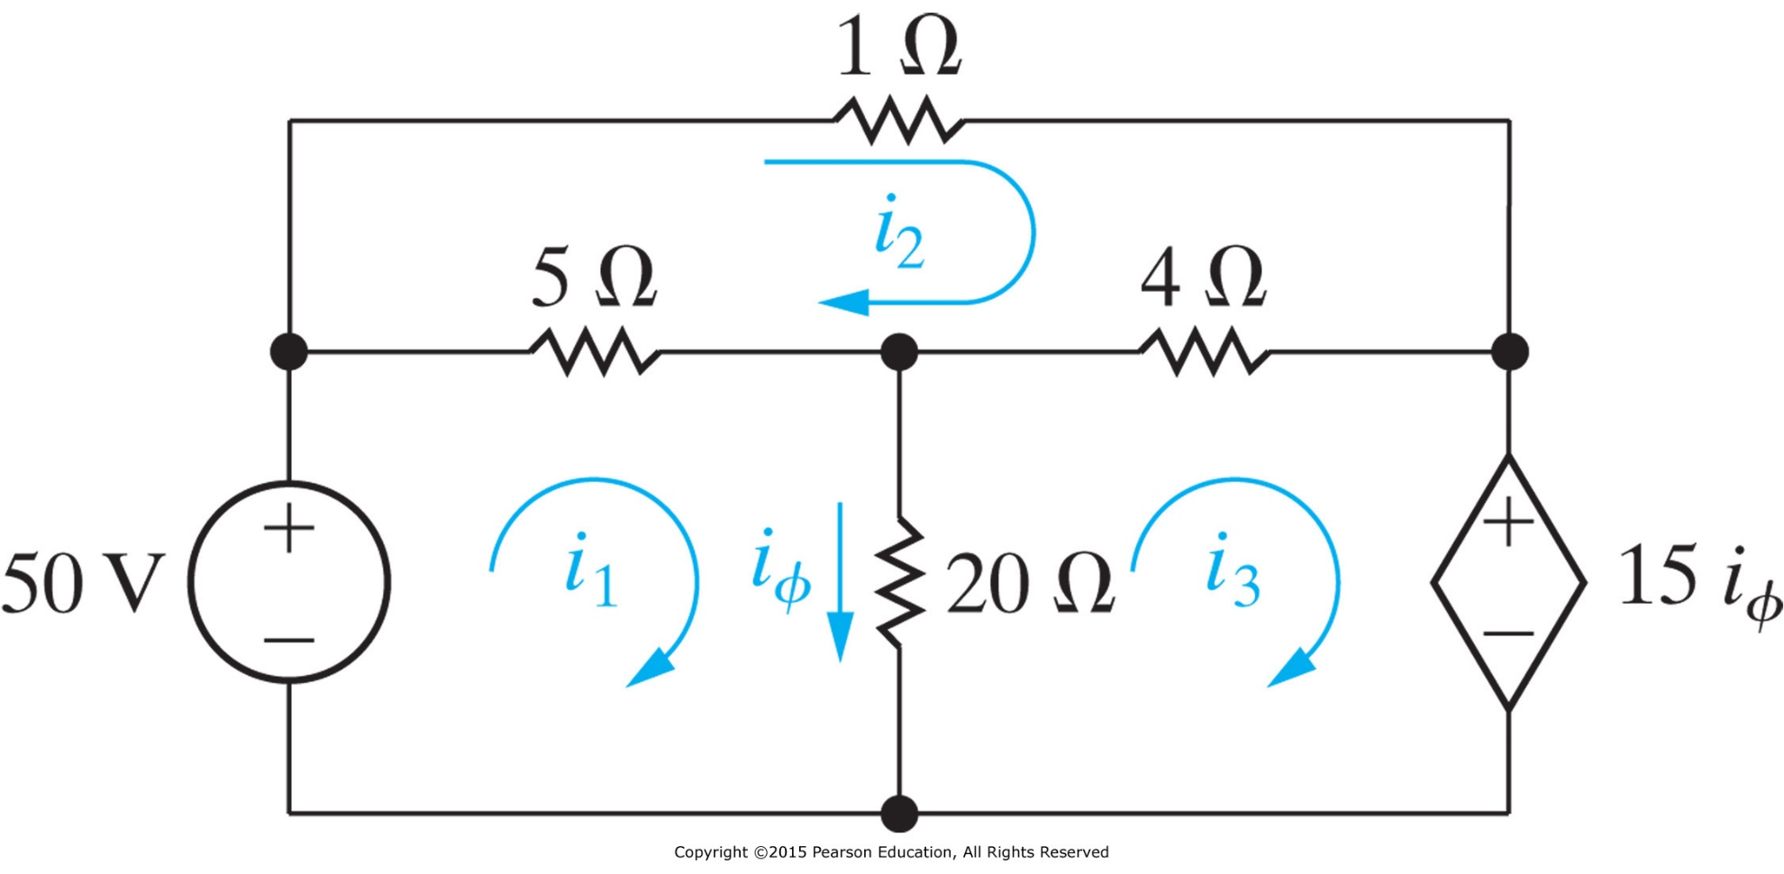
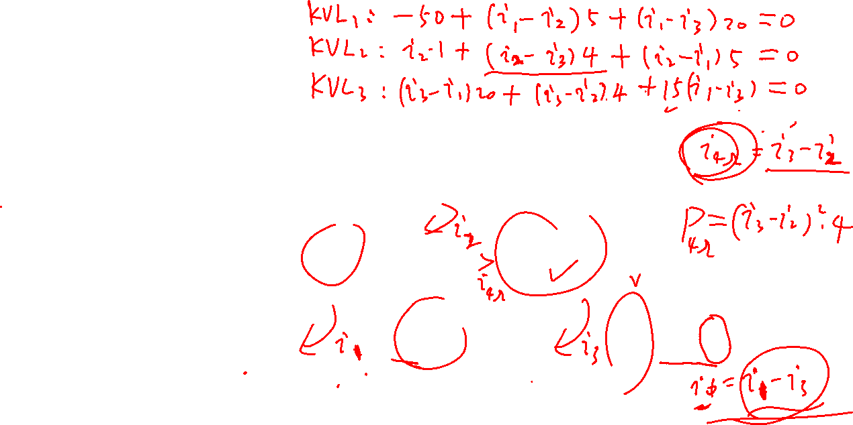
Practice
Use the mesh analysis to determine the power dissipated in the 4Ω resistor.

Slide 44
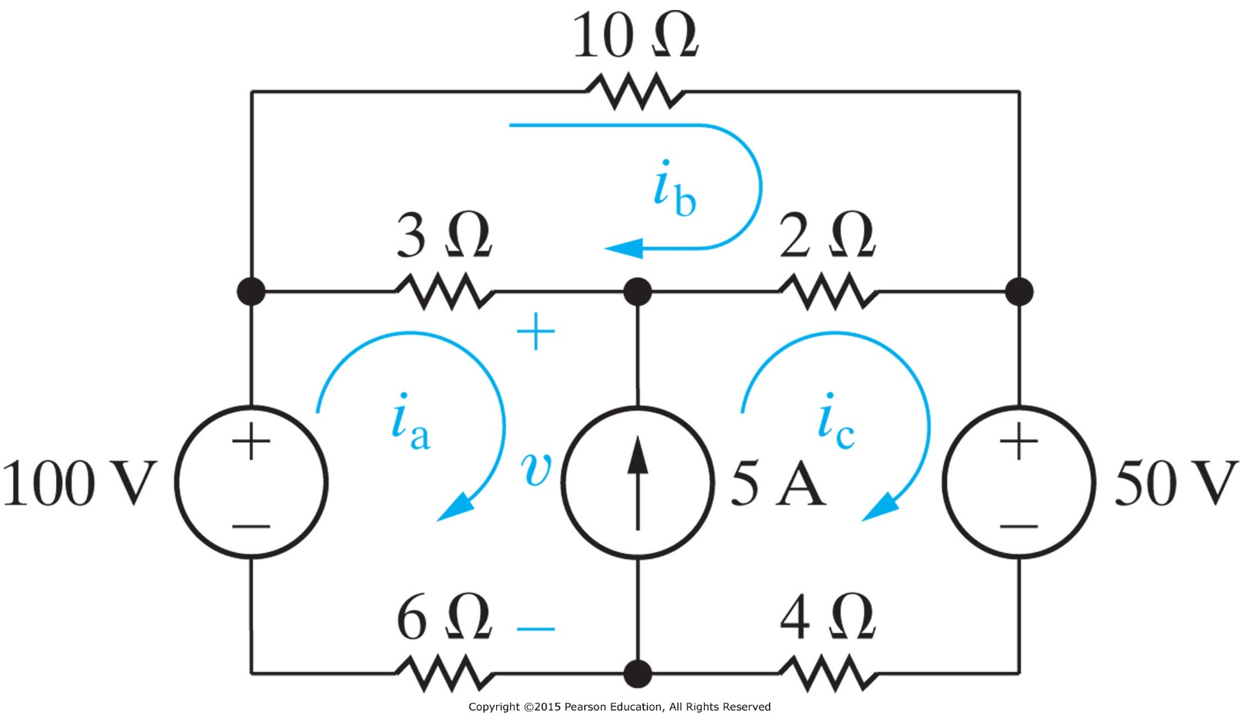

Practice
Find the three mesh currents in the circuit.

Slide 45

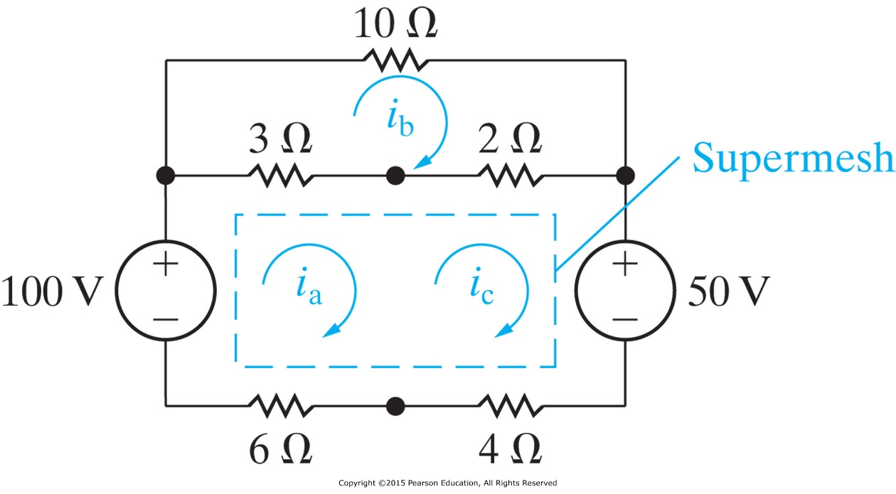
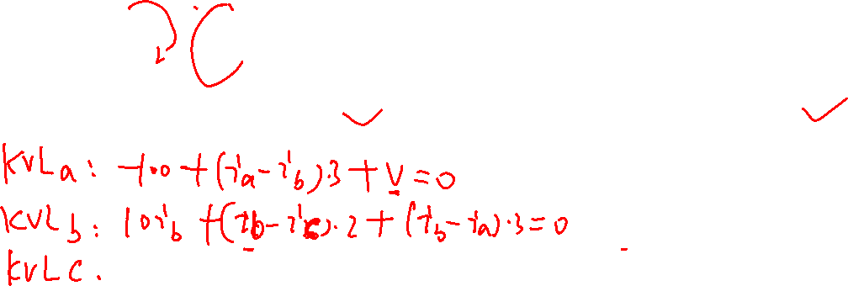
Practice

Slide 46
Outline
Nodal analysis
  circuits w/o a voltage source
  circuits w/ a voltage source (supernode trick)
Mesh analysis
  Circuits w/o a current source
  Circuits w/ a current source (supermesh trick)
Nodal analysis versus Mesh analysis
Notes:
Nodal analysis applies to any circuit; while mesh only to planar circuits. Computational circuit analysis using PSpice (Personal Simulation Program with Integrated Circuit Emphasis) will also be introduced here. See also the user forum: www.pspice.com

Slide 47
Nodal analysis or mesh analysis

Slide 48
Nodal vs Mesh Analysis
The greatest advantage of both methods is that they reduce the number of simultaneous equations that must be manipulated.
What then determines if one is going to be more efficient for solving a circuit problem?
There are two factors that dictate the better choice:
  The nature of the particular network
  The information required.

Slide 49
Nodal vs Mesh Analysis
The nature of the particular network
  Suitable for mesh analysis:
  Suitable for nodal analysis:
The information required:
  node voltage or branch/mesh current wanted?
  For nonplanar networks, can only use nodal analysis, because mesh analysis only applies to planar networks.
Many series connected elements
Voltage sources
Supermeshes
A circuit with fewer meshes than nodes
Many parallel connected elements
Current sources
Supernodes
A circuit with fewer nodes than meshes

Slide 50
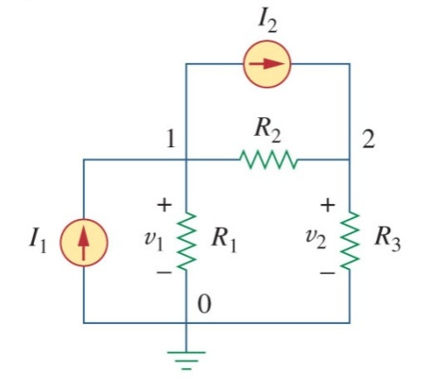
Nodal Analysis by Inspection
There is a faster way to construct a matrix for solving a circuit by nodal analysis
Recall, for this circuit the nodal voltage can be solved as:
Therefore, in general, for a circuit that contains only independent current
sources with N non-reference nodes, the node-voltage equations may be written as:
(conceptually: flow out current = flow in current)
Diagonal term G_{kk} is the sum of all conductance connecting to the k^{th} node.
The sum of all independent current sources directly injecting to the k^{th} node are denoted as i_{k}. Current entering the node are treated as positive.
Off diagonal terms G_{jk}=G_{kj} are the negative sum of all conductance between the j^{th} and k^{th} node.
Unknown nodal voltages

Slide 51
Mesh Analysis by Inspection
Similarly, there is a faster way to construct a matrix for solving a circuit by mesh analysis
Recall, for this circuit the mesh current can be solved as:
Therefore, in general, for a circuit that contains only independent voltage sources with N non-reference nodes, the mesh-current equations may be written as:
(conceptually: voltage drops = voltage rises)
Diagonal term G_{kk} is the sum of all sum of resistances in mesh k.
The sum taken clockwise of all voltage sources in mesh k are denoted as v_{k}. Voltage rises are treated as positive.
Off diagonal terms R_{jk}=R_{kj} are the negative sum of all resistances in common with the mesh j and k.
Unknown mesh currents in clockwise direction

Slide 52
Expected learning outcome
Be able to apply the mesh analysis and nodal analysis along relevant tricks to find the voltages and currents in a circuit.

